Slide 1
Smart Travel Planner
Supervisor: Dr. Hamid Turab
Abbas Ali fa17-bcs-087
Saeed Ahmad fa17-bcs-127
Ibad ur Rehman fa17-bcs-152

Slide 2
Categories
Table Of Content
Problem Statement
Scraping and Crawling data
Data Format
Algorithm
Conventional Neural Networks
Problem Faced
Future Work

Slide 3
Problem Statement
The trend of travelling is increasing day by day. So does the problem of choosing the right place to go.
A person who travels have some prior knowledge about the place but he/she still have to search for reviews and a lot of time will be wasted in this process.
A person can see the photos of places and can read the reviews about it from different persons. Then the problem arises of finding reviews by going to different platforms that will also cost a lot of time.

Slide 4
Problem Statement (continued…)
The project will contain a recommendation model to suggest places to users.
There will be extraction of user behavior and interests according to their search history using supervised and unsupervised machine learning techniques.
Real time user reviews are available for correct data generation and better model accuracy.

Slide 5
Scraping and Crawling Data
Phantombuster software is used to get data from google map.
In this project 11 categories of data is used for testing and training. (discussed latter)
Bing-image-downloader python library is used to scrape images for training.

Slide 6
Scraping and Crawling data (continued…)
Now by using the name of place 5 images of each location has been scrap.
Over three thousand record of places has been collected.
Number of scrap images are over 15000.
The images were not very high quality. Otherwise, the size of images would be relatively large.

Slide 7
Data Format

Slide 8
Algorithm
Algorithm first checks for noise in the image and apply adaptive AM filter on the image.
Then correct the contrast of the image using adaptive histogram equalization.
And at the last sharp the image using Laplacian filter with mask of [-1 -1 -1;-1 8 -1;-1 -1 -1].

Slide 9
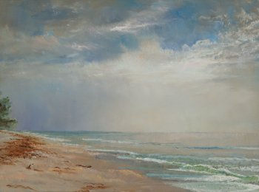
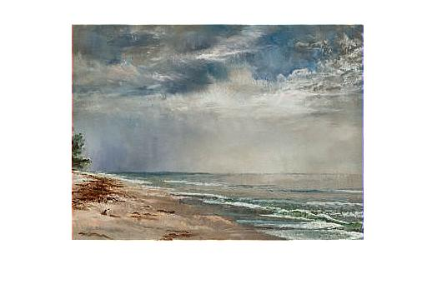
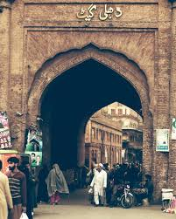
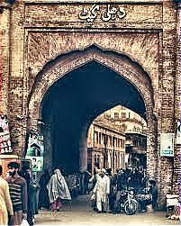
Algorithm (continued…)
Images appear to be low contrast such as
Before
After
Before
After

Slide 10
Categories
Creating a Conventional Neural Networks model that will predict these categories on an input image.
Gas Stations
Guest Houses
Historical Places
Hotels
Museums
Parks
Restaurants
Shopping Malls
Swimming Pools
Tourist Attraction

Slide 11
Conventional Neural Networks
After enhancement of image, images were given to convolutional neural network to predict the category of image.
For that purpose keras library and sequential model from keras library is used. which have four hidden layers of inputs 32,32,64,64 respectively. And 2 dense layers first one with 128 inputs and second with is the output layer with 11 outputs.
The model was trained on 30 epochs and gave good accuracy.
Multiclass technique will be used to achieve our required results.

Slide 12
Conventional Neural Networks (continued…)
This model have 4 hidden layers in model
1st and 2nd layers have 32 hidden units
3rd and 4th layers have 64 hidden units
This model have 2 dense layers in model
1st dense layer have 128 units
2nd dense layer has 11 units which represent output Categories
Activation function
This model used sigmoid as activation function

Slide 13
Conventional Neural Networks (continued…)
This model use
“he_uniform” as kernel_initializer
Softmax activation function in output dense layer
“rmsprop” as optimizer
categorical_crossentropy

Slide 14
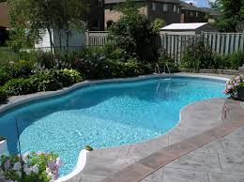
Result of Models
Image given
Result :
{'Gas Stations': 0, 'Guest Houses': 1, 'Historcal Places': 2, 'Hotels': 3, 'Meuseums': 4, 'Parks': 5, 'Religious Places': 6, 'Restaurants': 7, 'Shooping Malls': 8, 'Swimming Pools': 9, 'Tourist Attraction': 10}
Output : [9]
And 9 represent swimming pool class.

Slide 15
Recommendation Model
User’s interest are captured on the basis user’s search history
The interest captured are passed onto the model and model will predict locations to the user.
The model is working in two ways:
First one is the user will get the locations which is close to it according to its interest.
Second one the model will predict the highest rated locations which matches user’s search interest.

Slide 16
Recommendation Model (continued…)
Input:
The input will be search interest of the users and it will be in a form of an array,
Like this:
[
‘Restaurants’,
‘Hotels’,
‘Historical Places’
]

Slide 17
Recommendation Model (continued…)
Output:
The output will be an array of the locations which contain the latitude, long and picture of the location and many other prams which is showing below:
Accuracy:
The accuracy of the model is almost 60%. This can be increased if the training data will be made more robust and clean.

Slide 18
Mobile App
A mobile app is created using react-native platform that will be useful for both android and iOS devices.
Mern Stack platform is being used for this whole project. The backend of the system is using NodeJS.
The App is deployed on AWS EC2 instance.
The App is using AWS S3 bucket for all the data storage.
The App is using MongoDB as its database.

Slide 19
Functionalities of App
Social login and login through email into the app.
Nearest locations according to user’s search interest.
Highest Rated locations according to user’s search interest.
User can search places and recommendations will be given through google-maps-places API.
Any place the user will search will be shown onto the map with the detail and pictures.
The places which will be recommended by the model will also contain detail and pictures.

Slide 20
Functionalities of App (continued…)
Proper search filter mechanism will be provided to narrow down search according to user.
User can comment and provide rating to the place he/she will visit.

Slide 21
Problem Faced
Group projects works just well for R&D projects and produces effective outcomes, but it is not easy to chain all the ideas in a single project.
Outlining the tasks of the group members and synchronizing with the supervisors on the given time is very vital and one thing that is learned here is to work good and more in fewer time.
To increase accuracy of model preprocessing on the images is performed in which digital image processing and CNN techniques were very helpful.
To make the app more fruitful the MERN stack platform, AWS was very helpful.

Slide 22
Future Work
User will be suggested routes and directions using google map API.
User’s profile will be managed properly in the app.
App setting menu will be created.
App ‘Help & Support’ menu will be created.
‘All Visited Places’ screen will be created.

